Slide 1
Software Engineering
Research Project--LEAN 4 for the Math Theorem Proving
Langze YE
Xuan ZHANG
Jiaheng XIONG

Slide 2

LEAN 4 for the Math Theorem Proving
Jiaheng Xiong, Langze Ye
Politecnico di Milano
1
About LEAN
2
Proving infinity of prime numbers
3
Conclusion

Slide 3
About LEAN What is Lean?
3
Lean is an advanced programming language designed to advance mathematical reasoning, formal verification, and logical inference.
It blends computer science and mathematics to provide powerful tools for formal methods.
Lean emphasizes precision and logic, it can be used not only to write algorithms, but also to prove the correctness of those algorithms
[1] Verizon Enterprise Solutions, “Data Breach Investigation Report,” 2020, https://enterprise.verizon.com/resources/reports/2019-databreach-investigations-report.pdf
[2] Statista: IoT Devices Forecasts from 2022 to 2030. Available online: https://www.statista.com/statistics/1183457/iot-connecteddevices-worldwide/ (accessed on 1 July 2022).
Notes:
To establish an entanglement connection one must first create entanglement links, called external links between adjacent nodes.Then, repeaters perform entanglement swapping and send results to the destination which logically creates the so-called internal links [10, 11] shown as dotted links inside the two repeaters, to patch together the entanglement links incident on them, in order to establish an entanglement connection.

Slide 4
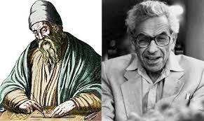
II. Proving infinity of prime numbers Euclid's theorem
4
Consider any finite list of prime numbers p1, p2, ..., pn. It will be shown that at least one additional prime number not in this list exists.
Let P be the product of all the prime numbers in the list: P = p1p2...pn.
Let q = P + 1.
q is prime or q is not a prime

Slide 5
II. Proving infinity of prime numbers Euclid's theorem
If q is prime, then there is at least one more prime that is not in the list, namely, q itself.
If q is not prime, then some prime factor p divides q. If this factor p were in our list, then it would divide P (since P is the product of every number in the list); but p also divides P + 1 = q, as just stated. If p divides P and also q, then p must also divide the difference of the two numbers, which is (P + 1) − P or just 1. Since no prime number divides 1, p cannot be in the list. This means that at least one more prime number exists beyond those in the list.

Slide 6
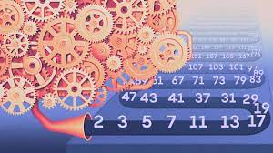
II. Proving infinity of prime numbers Euclid's theorem
There is a prime number greater than n.
To prove this, let p be any prime factor of n! + 1. If p is less than n, it divides n!. Since it also divides n! + 1, it divides 1, a contradiction. Hence p is greater than n.
[1] CVE - CVE-2014-0160. https://www.cve.org/CVERecord?id=CVE-2014-0160.

Slide 7
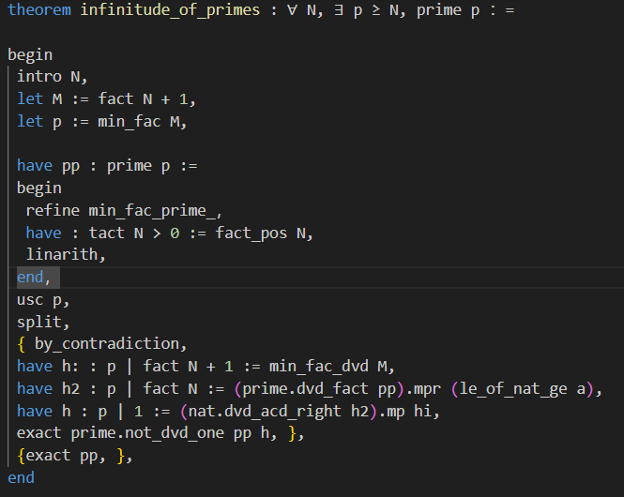
II. Proving infinity of prime numbers Proving in LEAN
-Formalization of the problem
- Write the proof process and verify correctness

Slide 8
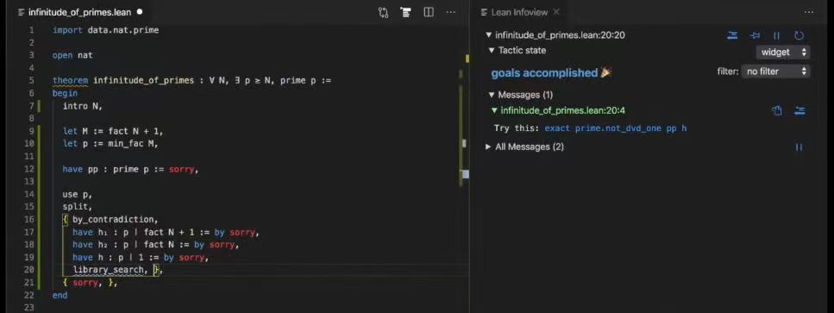
II. Proving infinity of prime numbers Proving in LEAN

Slide 9
III. Conclusion
Advantages and disadvantages of the lean language
Advantages
Disadvantage
Lean supports highly accurate formal verification that can be used to prove the correctness of mathematical theorems, software
Interactive theorem provers can help prove or enliven the user's mind
LEAN 4 has a relatively steep learning curve and takes some time and effort to master
Facing complex problems will require more expertise and programming ability.
The configuration of the compilation environment and the import of libraries are complex
Notes:
This is the result of our method, it’s much better than previous work.

Slide 10
Thank you!
Notes:
Thank you for your attention! I’m here. Please if you have any question, I will be happy to answer your questions.

